Slide 1
PRECIS WRITING
BY NOSHABA FRAZ

Slide 2
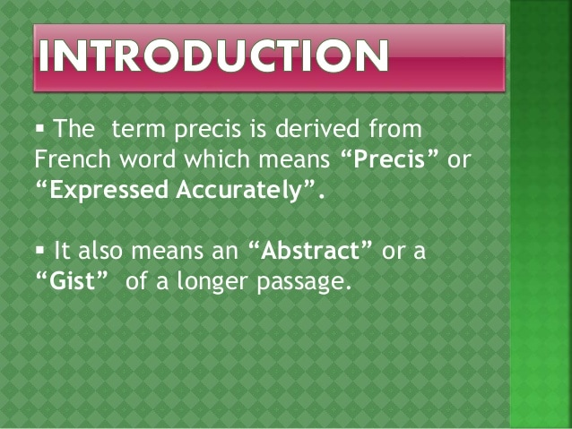

Slide 3
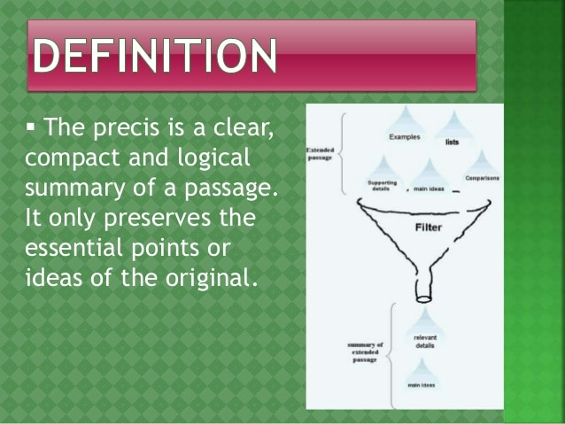

Slide 4
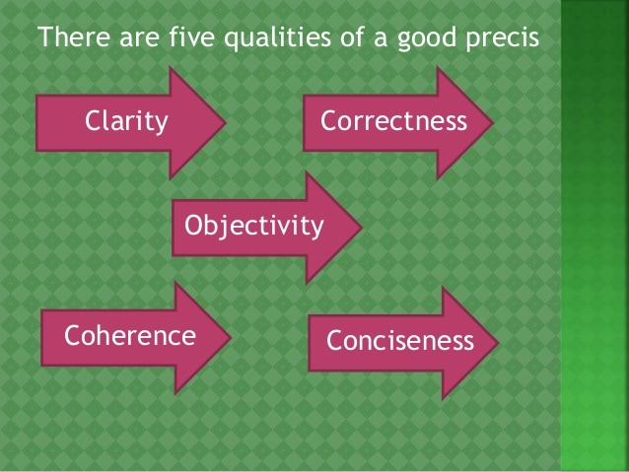

Slide 5


Slide 6
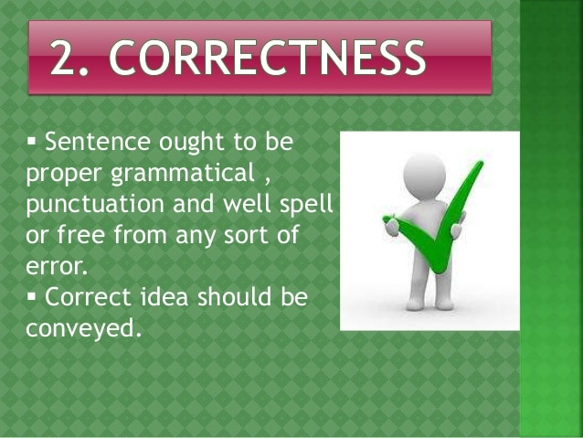

Slide 7
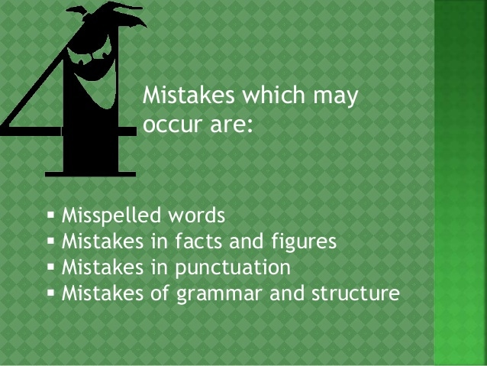

Slide 8
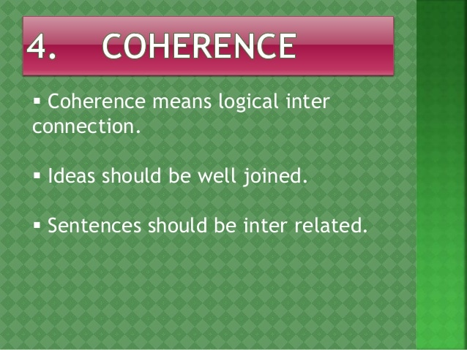

Slide 9


Slide 10
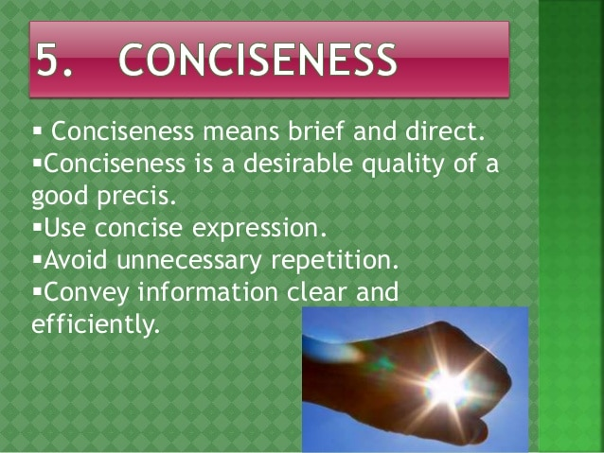

Slide 11
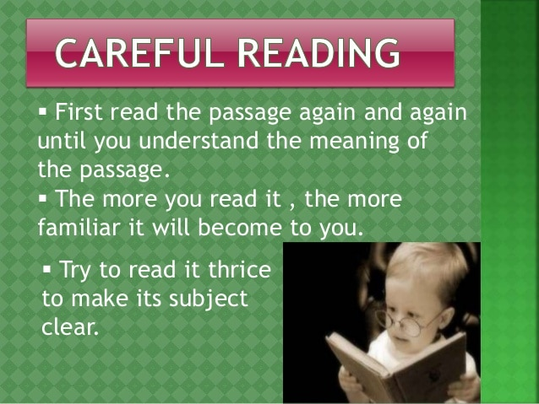

Slide 12
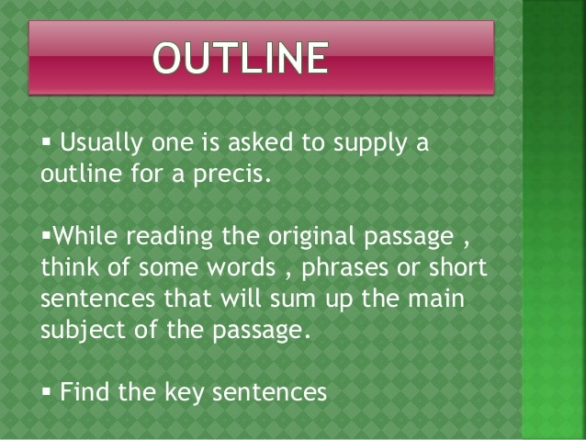

Slide 13
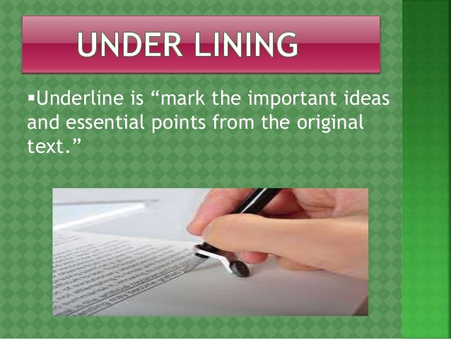

Slide 14
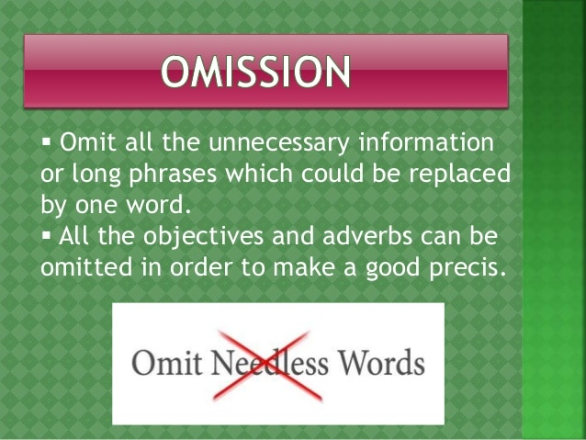

Slide 15
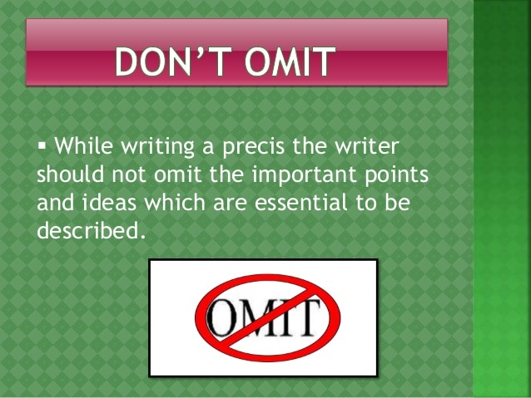

Slide 16
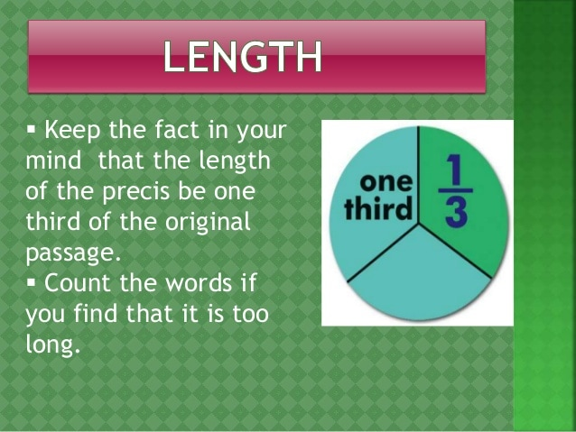

Slide 17
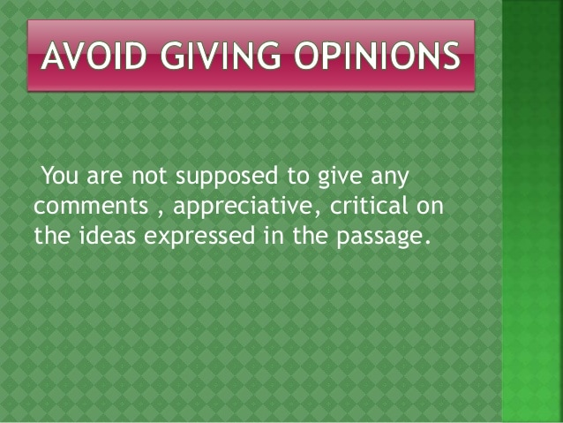

Slide 18


Slide 19
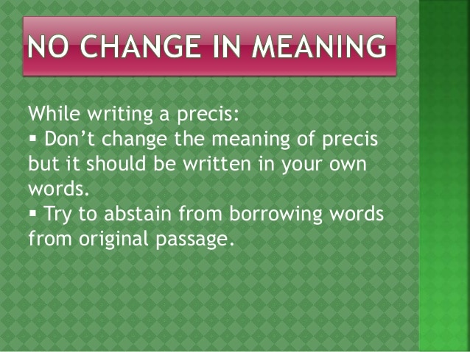

Slide 20
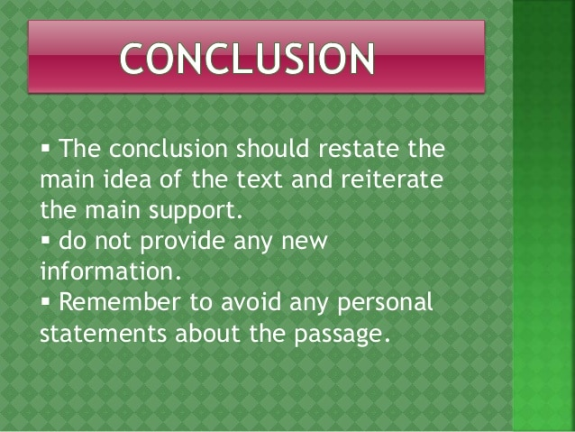

Slide 21
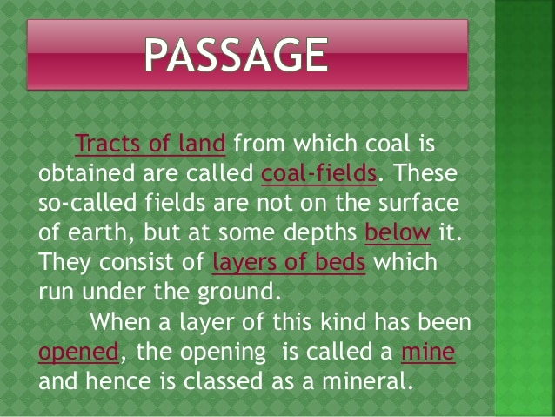
ACTIVITY

Slide 22
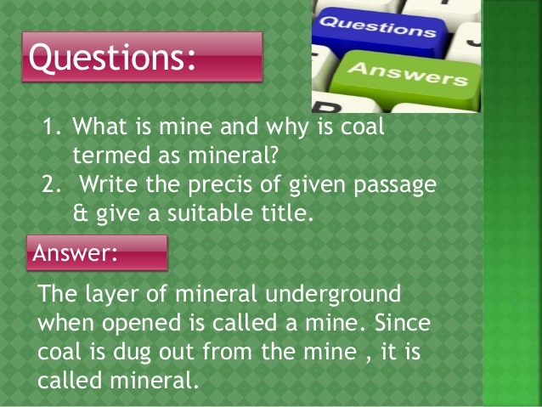

Slide 23
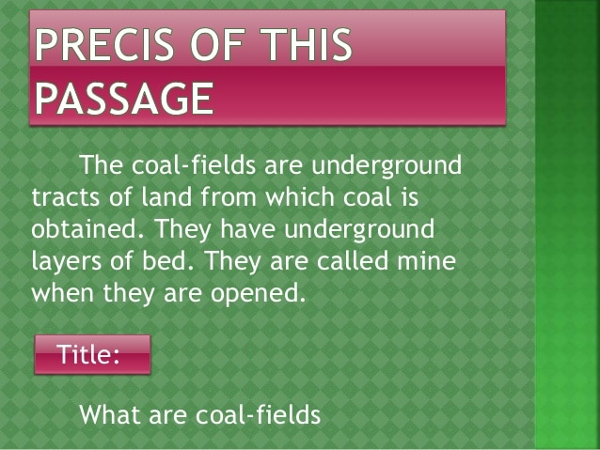

Slide 24
Exercise
A recent visit to the Arctic region brought me face to face with the problem of global warming. It made me realize how massive the change is and how grave its consequences will be for all. The ice caps in the Polar Regions are melting rapidly due to deforestation and the increasing levels of carbon dioxide in the atmosphere. If steps are not taken soon, the rising water levels will submerge all the landmasses.
Ozone depletion is another serious consequence of global warming. These holes or breaches in the protective cover of our planet let harmful UV rays reach us unfiltered. They in turn cause health hazards that are very difficult to treat. Awareness of these effects of our actions and sustainable steps to prevent them is the need of the hour. (134 Words)

Slide 25
Important points
Global warming can lead to grave consequences.
Ice caps are melting rapidly.
Rising water levels a threat to land masses.
Global warming is causing ozone depletion and health hazards.

Slide 26
Precis writing
Title: Global Warming
PRÉCIS: The consequences of global warming are grave. The ice caps, which are melting due to deforestation and the increasing levels of carbon dioxide can cause a rise in the water levels and submerge landmasses. Global warming can lead to ozone depletion. Lack of preventive measures can either cause health hazards or extinction of species. (55 words)

Slide 27
References
R.Dhillon, ( 2010 ). Precis writing . A.H Publisher
info@cssbooks.net
www.csstimes.pk

